Slide 1
























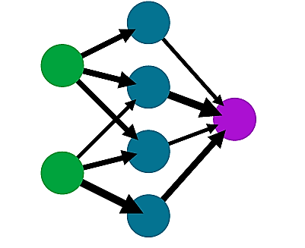




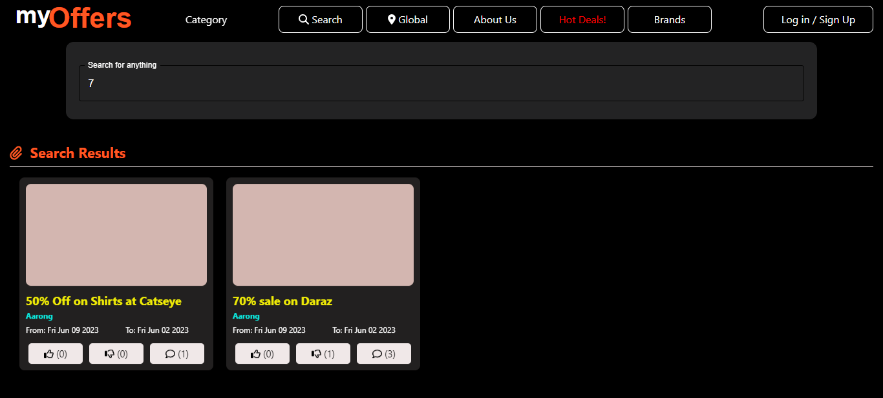
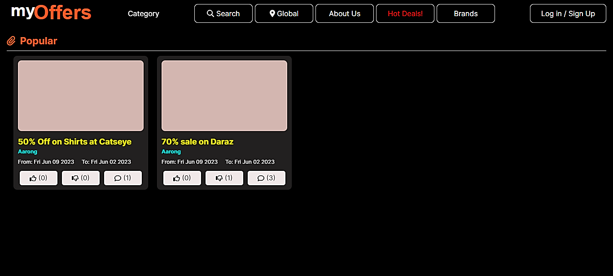





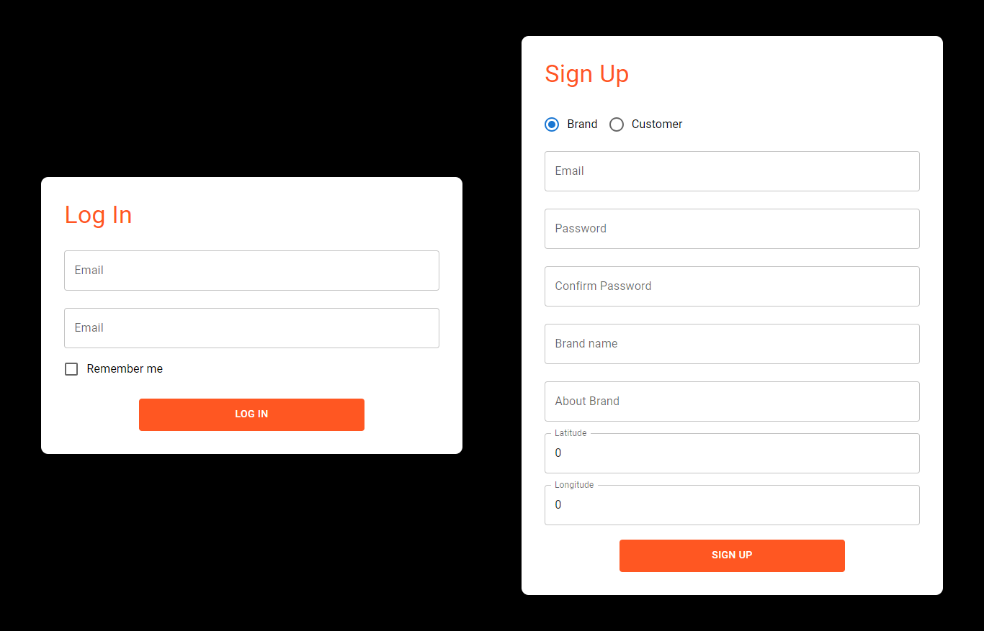


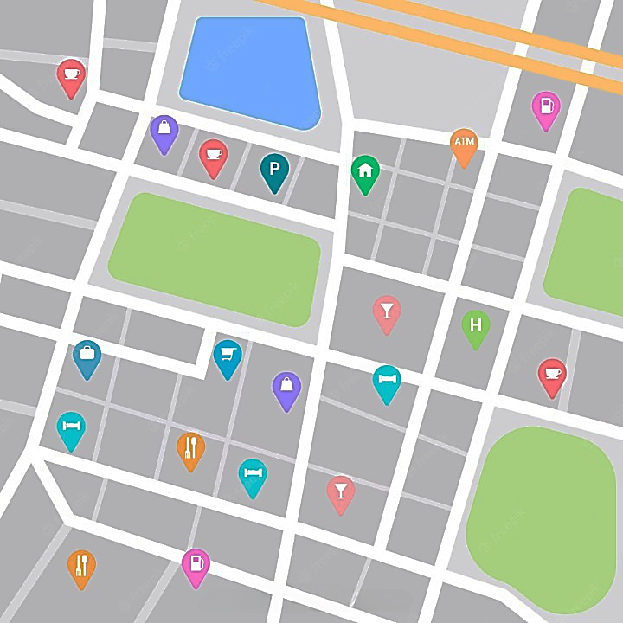




myOffers – Unleash the Power of Deep Learning for Global Offers Discovery
Tonmoy Chandro Das
Supervisor Name: Professor Dr. Iqbal Ahmed, Dr. Abu Nowshed Chy
Department of Computer Science & Engineering, University of Chittagong, Bangladesh
Introduction
Motivation
Problem Statement
Need to buy a gift…
Sellers
Offline shops
Posting Offers
More sales with less cost
Searching
Buying the gift
(5% time)
with
Location based offer
Brand-wise offers
Decision
Searching
Ongoing offers
Category wise offers
Need of
a specific
product
Centralized Offer base
Getting
Best Deals
Advance offer announcement
Budget wise offers
Online Brands
Social Media Ads
Unknown and Missing options
Users
Offers around the internet
Searching and Comparing among different options
(95% time)
Product wise offers
Admin Panel
System Overview
(Unregistered Users)
Single registration process using RESTful API
Search & Visit
React & Comment on Offers
Review Brand
Search and Visit
Getting the Best deals from genuine source
(General Users)
Registration
Email
verification
myOffer
Registration Process
(Registered account
skips this process)
Create Offer Posts
Get Reviewed
Reach out to customers
System Usage
Reaching out to potential customers with less marketing cost
(Brands, Online &
Offline Shops)
(Easy User Interface
with session management)
Result
Features of Our Proposed System
Multiple Searching Option
CNN model for better
search result
One map for all Offers
Find out best Brands
Search by Product Name
Search by budget
Search by Brand
Search by Image
Find nearby offers
Find all offers around the world
Users can review brands
Higher Rating - Better Brands
Users can react & Comment
System Demonstration
Review brands
Filter
Offers
Search by brands, offers, category or anything…
Starbucks
Logged in
Users only
Special Features
Buy 1, Get 1
70% Off!
Free gifts!
Free gifts!
React, comment
Offers Map
Landing Page
Brand Name
myOffer Map
No need of authentication
to checkout
offers and
brands
Buy 1 - Get 1
Offer
email
Authentication
email
Password
Password
Log In
Confirm
(Easy Sign up process through email verification)
Sign Up

